Slide 1
Lesson 3.4
Technical Tools for Oil Spill Planning and Response
CGPRT(W) : Ensuring Clean Seas and Coasts in Western Region ……

Slide 2
Objective
To understand the technical aspects and tools available for oil spill preparedness and response especially oil behaviour, sensitivity maps and modelling.
CGPRT(W) : Ensuring Clean Seas and Coasts in Western Region ……

Slide 3
Technical Aspects
Contingency planning and response must be supported by sound technical knowledge and tools.
These will facilitate decision-making processes.
The main technical aspects to consider are:
  Oil fate and behaviour
  Oil spill modelling
  Sensitivity mapping.
CGPRT(W) : Ensuring Clean Seas and Coasts in Western Region ……

Slide 4
Oil Fate and Behaviour
CGPRT(W) : Ensuring Clean Seas and Coasts in Western Region ……

Slide 5
Oil Behaviour
Physical and chemical processes will change oil properties and behaviour once spilled into the environment.
These processes are referred to as “oil weathering”.
Oil weathering will influence the selection of appropriate response strategies, affect operations and oil toxicity.
CGPRT(W) : Ensuring Clean Seas and Coasts in Western Region ……

Slide 6
Important Oil Properties
Specific gravity/ºAPI:
  density
Viscosity:
  resistance to flow
Pour point:
  temperature below which oil does not flow
Volatility:
  propensity to evaporate
Asphaltene content:
  propensity to emulsify
CGPRT(W) : Ensuring Clean Seas and Coasts in Western Region ……

Slide 7
Fate and Behaviour of Spilled Oil
Major processes:
Drifting
Spreading
Evaporation
Emulsification
Dispersion
Biodegradation
Dissolution
Photo-oxidation
Sedimentation
Shoreline interaction
CGPRT(W) : Ensuring Clean Seas and Coasts in Western Region ……

Slide 8
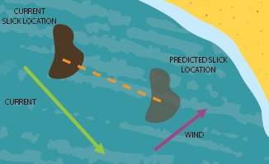
Drifting at Sea
Oil will drift at sea under the influence of currents and winds.
100% current direction and speed, approximately 3% wind direction and speed.
CGPRT(W) : Ensuring Clean Seas and Coasts in Western Region ……

Slide 9
Wind effects
Wind
Wind
Wind
CGPRT(W) : Ensuring Clean Seas and Coasts in Western Region ……

Slide 10
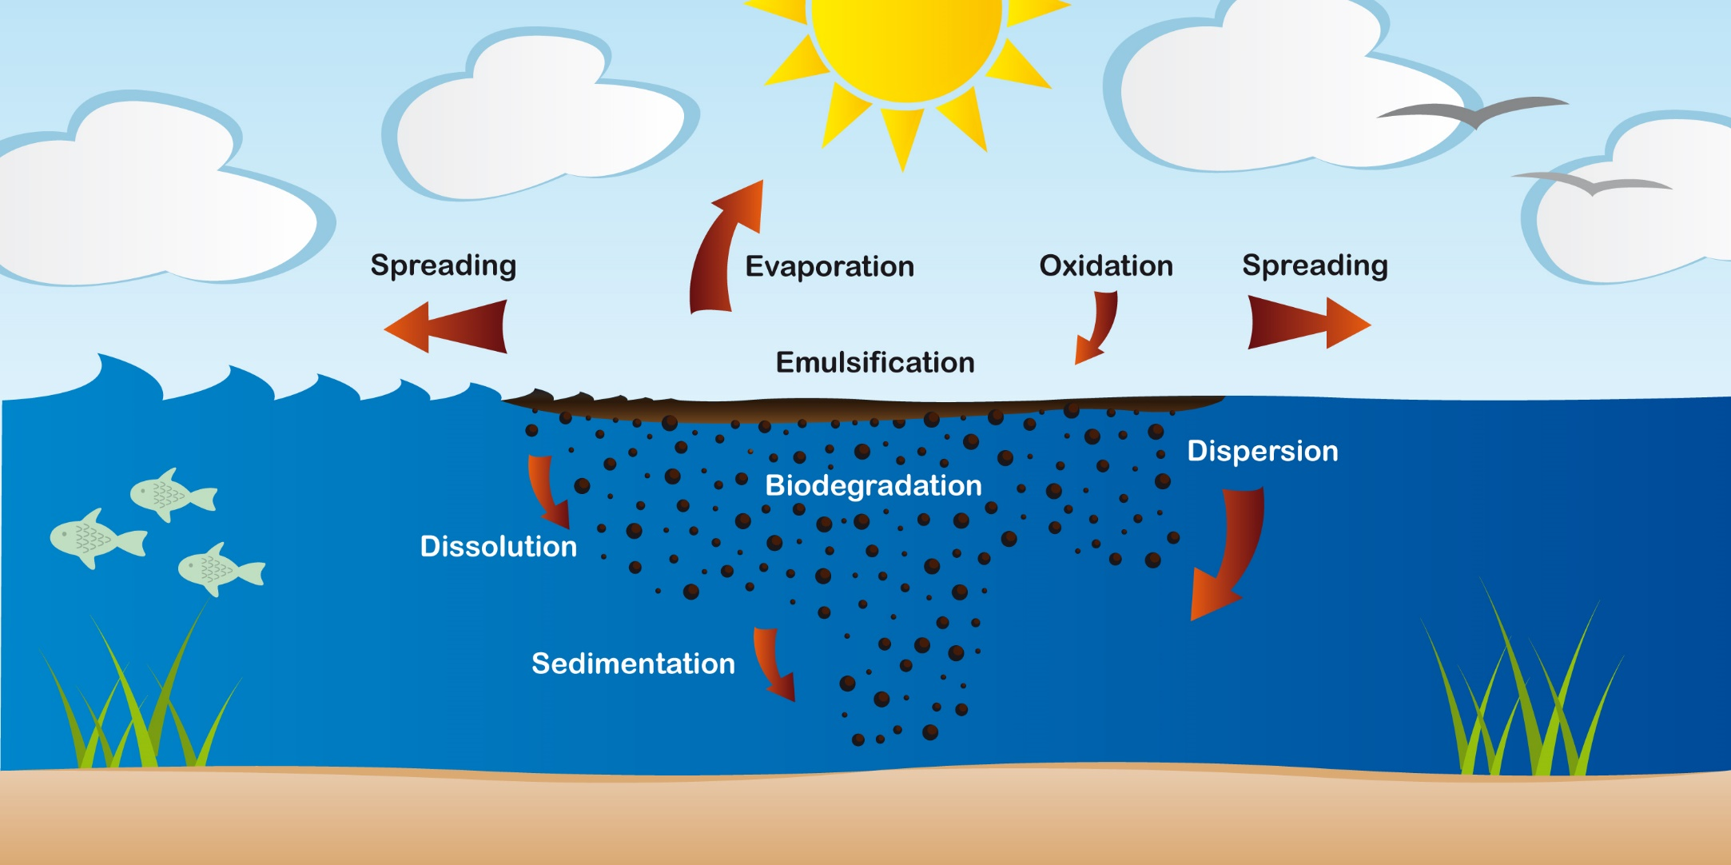
Weathering Processes
CGPRT(W) : Ensuring Clean Seas and Coasts in Western Region ……

Slide 11
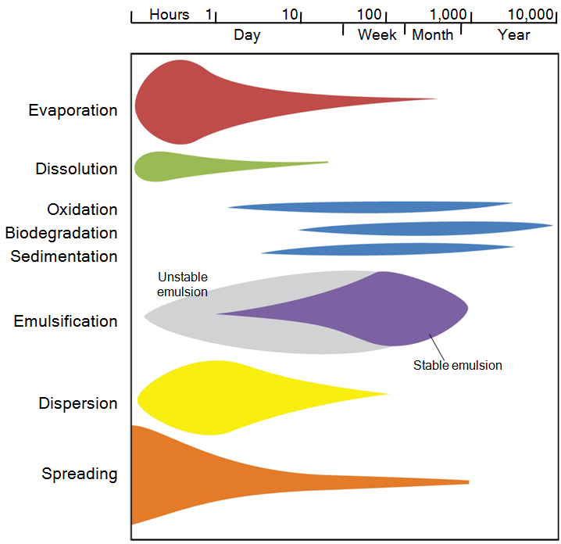
Weathering Processes Over Time
CGPRT(W) : Ensuring Clean Seas and Coasts in Western Region ……

Slide 12
Effects of Main Weathering Processes
EVAPORATION
Reduction in volume
Increase viscosity
DISPERSION
Reduction in volume
Enhances biodegradation
EMULSIFICATION
Increase in volume
Increase viscosity
CGPRT(W) : Ensuring Clean Seas and Coasts in Western Region ……

Slide 13
Oil Spill Modelling
CGPRT(W) : Ensuring Clean Seas and Coasts in Western Region ……

Slide 14
Oil Spill Modelling
Useful tool for oil spill preparedness and response
Oil spill models will provide information on:
  Oil weathering
  Trajectory
Example of oil weathering and trajectory models:
  ADIOS and GNOME (NOAA)
CGPRT(W) : Ensuring Clean Seas and Coasts in Western Region ……

Slide 15
Oil Spill Modelling
Types of models:
  Oil weathering (weathering over time)
  Stochastic (probability of impacts)
  Deterministic (oil trajectory over time)
  Hind-cast (identification of spill sources)
  3D (modelling of water column)
CGPRT(W) : Ensuring Clean Seas and Coasts in Western Region ……

Slide 16
Oil Spill Modelling
Types of models:
  Oil weathering (weathering over time)
  Stochastic (probability of impacts)
  Deterministic (oil trajectory over time)
  Hind-cast (identification of spill sources)
  3D (modelling of water column)
CGPRT(W) : Ensuring Clean Seas and Coasts in Western Region ……

Slide 17
Oil Spill Modelling
Data requirements:
  Hydrodynamic data (surface currents, speed and direction)
  Wind data (speed and direction)
  Oil type
  Temperature (air and sea)
Caution:
  Output quality is highly dependent on data quality
  In a spill situation, modelling results must be validated by field observations
CGPRT(W) : Ensuring Clean Seas and Coasts in Western Region ……

Slide 18
Sensitivity Maps
CGPRT(W) : Ensuring Clean Seas and Coasts in Western Region ……

Slide 19
Sensitivity Maps
Essential tool for preparedness and response
Facilitate the decision-making process
Show locations of sensitive areas and their relative importance
Assist responders in identifying response priorities and potential consequences
CGPRT(W) : Ensuring Clean Seas and Coasts in Western Region ……

Slide 20
Uses of Sensitivity Maps
For contingency planning:
    Location of sensitive areas
    Protection priorities
For spill response strategies:
    Dispersant prohibition areas
For shoreline protection strategies:
    Booming points
    Enhanced collection areas
For clean-up strategies:
    Beach types
    Access roads; near shore water depths
CGPRT(W) : Ensuring Clean Seas and Coasts in Western Region ……

Slide 21
Sensitive Resources
Economic:
  industry
  tourism
  fishing areas
  aquaculture facilities
Social:
  residential areas
  recreational beaches
Environmental:
  Shoreline types
  Important areas (bird colonies; habitats, marshes; corals)
CGPRT(W) : Ensuring Clean Seas and Coasts in Western Region ……

Slide 22
Priority Ranking
Sensitive areas can be ranked according to their relative sensitivity to oil and clean-up difficulty.
It provides a quick overview of highly sensitive areas.
Development of sensitivity maps:
  Working group with relevant stakeholders
  Compile information on resources and location
  Determine ranking
  Produce maps (GIS support).
CGPRT(W) : Ensuring Clean Seas and Coasts in Western Region ……

Slide 23
High Priority Biological Resources
Marshes and mangroves | Highly vulnerable
Protected areas/ endangered species | Highly vulnerable
Sites of national and international importance for water birds | Highly vulnerable
Turtle nesting beaches | Highly vulnerable during breeding season
Coral reefs | Highly vulnerable
CGPRT(W) : Ensuring Clean Seas and Coasts in Western Region ……

Slide 24
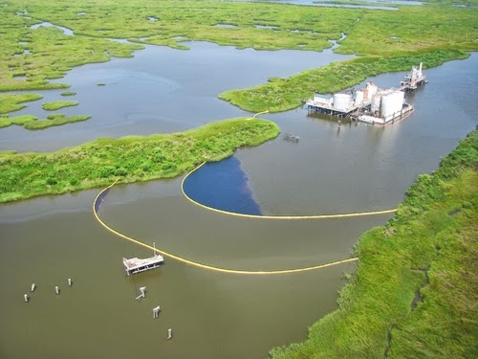
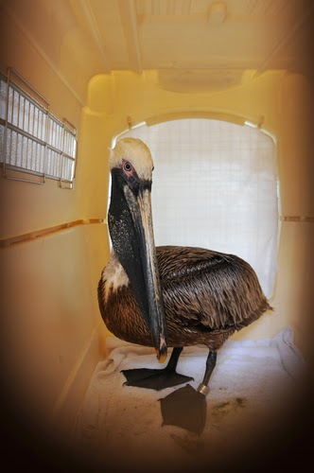
Sensitive Resources − Biological
CGPRT(W) : Ensuring Clean Seas and Coasts in Western Region ……

Slide 25
Ranking of Human Use
High priority | Tourist areas: Recreational beaches Marinas Water intakes Fishing grounds
Medium priority | Ports and harbours Urban areas Industrial areas Fishing grounds
Low priority | Unused land
CGPRT(W) : Ensuring Clean Seas and Coasts in Western Region ……

Slide 26
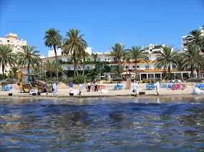
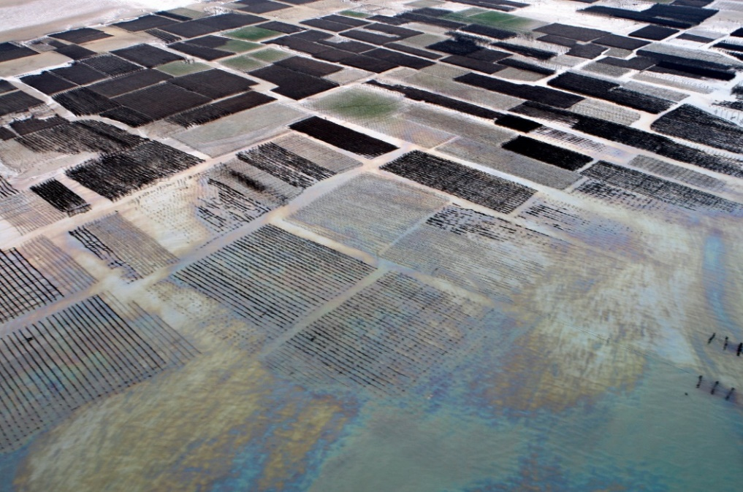
Sensitive Resources – Human Use
CGPRT(W) : Ensuring Clean Seas and Coasts in Western Region ……

Slide 27
High Priority Shorelines
Marshes and mangroves
Reef flats which are exposed at low tide
Raised fossil reefs with undercuts
Boulder and cobble beaches
Pebble and cobble beaches
CGPRT(W) : Ensuring Clean Seas and Coasts in Western Region ……

Slide 28
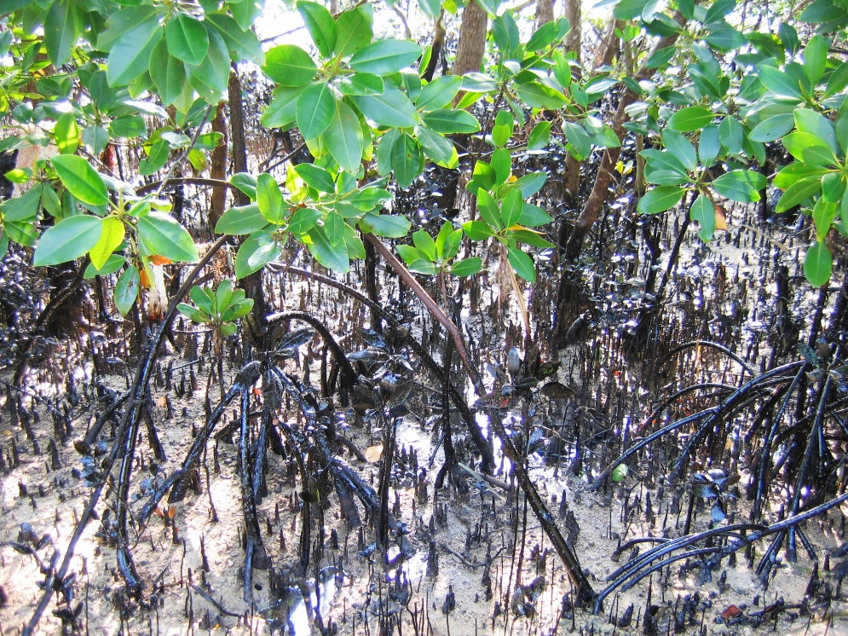
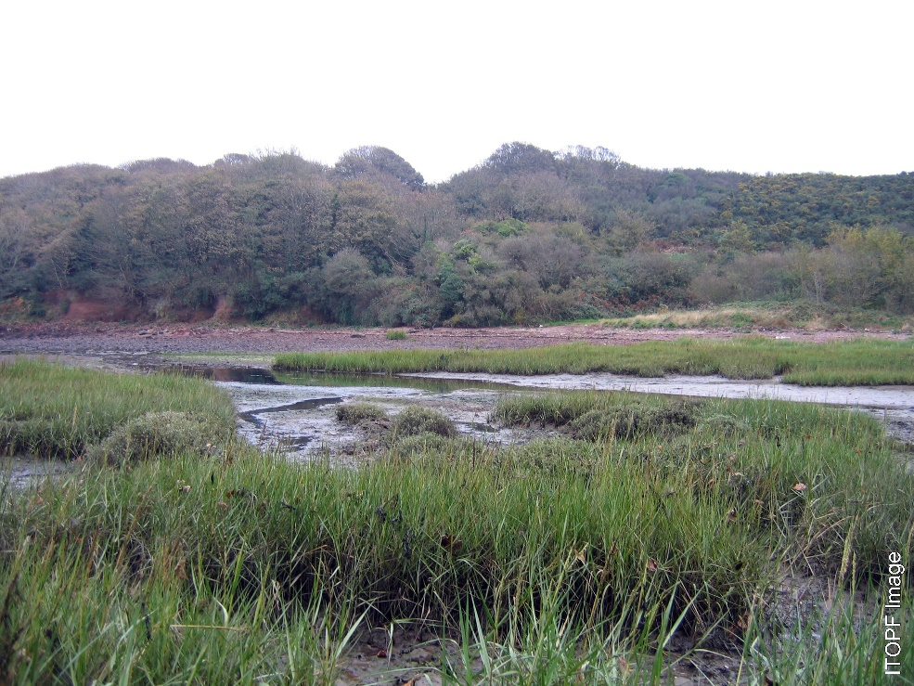
Sensitive Resources – Shorelines
CGPRT(W) : Ensuring Clean Seas and Coasts in Western Region ……

Slide 29
Conclusion
Technical aspects are very important for oil spill preparedness activities and response
They are the basis for decision-making
Technical tools such as oil spill models and sensitivity maps will facilitate the decision- making process for managers
CGPRT(W) : Ensuring Clean Seas and Coasts in Western Region ……

Slide 30
Any questions?
CGPRT(W) : Ensuring Clean Seas and Coasts in Western Region ……

